Slide 1

CREATIVITY & INNOVATION IN SECONDARY SCHOOLS
USEEP FOR HEAD TEACHERS & DEPUTY HEAD TEACHERS OF SECONDARY SCHOOLS

Slide 2
Session Objectives
By the end of the session, participants should be able to;
clearly distinguish between creativity and innovation.
generate at least 3 new product or service innovative ideas.
identify the common hindrances of creativity & innovation at your school, and propose mitigations.
Creativity & Innovation in Secondary Schools

Slide 3
What is Creativity?
The merging of ideas which have not been merged before.
New ideas are formed by developing current ones within our minds.
(Source: Lotherington, 2008).
Creativity & Innovation in Secondary Schools

Slide 4
What is Innovation?
The process by which entrepreneurs convert opportunities into marketable ideas (Howell & Higgins, 1990)
Creativity & Innovation in Secondary Schools

Slide 5
Creativity vs Innovation
Creativity is the starting point for innovation; the two concepts differ in terms of their focus and outcomes.
Creativity is about generating new ideas, while innovation is about bringing those ideas to fruition and creating value.
Thus, Innovation requires creativity, but creativity can stand alone.
Creativity & Innovation in Secondary Schools

Slide 6
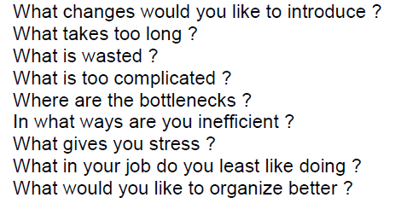
Guiding Questions of the project ideas
Creativity & Innovation in Secondary Schools

Slide 7
Group Work
Break into 4 groups
Each group to generate at least 3 new product or service innovative ideas that can be developed into an enterprise project at your school.
NB;
1. Provide justification for the choice of your products.
2. Brieftly explain how the chosen product will be provided.
Creativity & Innovation in Secondary Schools

Slide 8
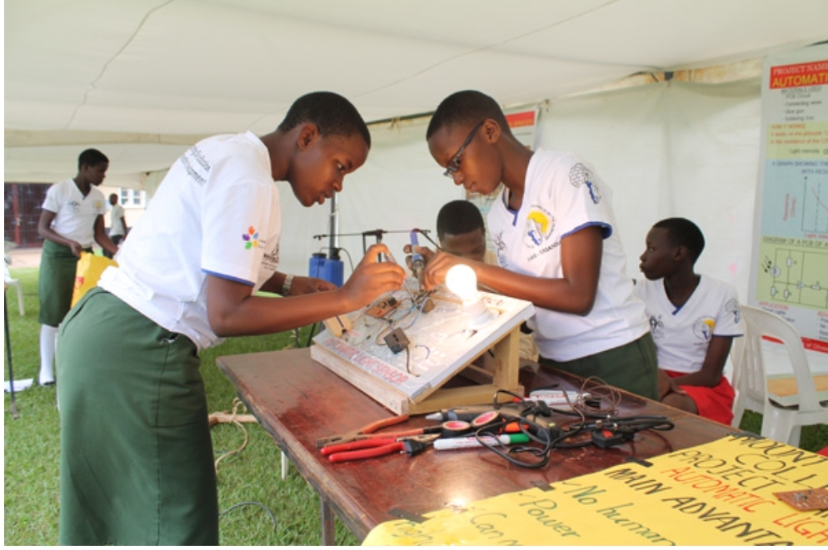

Examples of innovations by secondary schools
Creativity & Innovation in Secondary Schools

Slide 9
Interactive session
What are the common hindrances of creativity & innovation at your school
Suggest the ways these hindrances can be mitigated.
Creativity & Innovation in Secondary Schools

Slide 10
Thanks for Your Participation
Questions and Concerns are welcome!!!
Creativity & Innovation in Secondary Schools

